Slide 1
Mid-Term Project
Building a model to predict cancer mortality rates

Slide 2
Agenda
Project Goal
Dataset
Exploratory Data Analysis
Tableau
Python
Challenges
Data Cleaning and Processing
Model Building and Results
Summary
Outlook

Slide 3
Project Goal
Goal
Method
Tools
Predict cancer mortality rates in the USA and identify the most important impact factors
OLS linear regression models
Optimize through data transformation and preprocessing
Find the highest accuracy and lowest errors scores
Python:
Data joining
Data exploring
Data preprocessing
Model building
Tableau
Data exploring

Slide 4
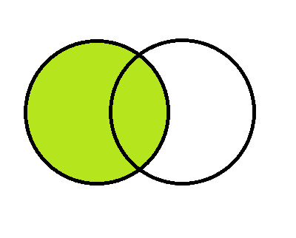
An interesting dataset made even better (?)
2. Dataset
Cancer regression challenge
Industry density
urban/rural
UV exposure
Aggregated data on us-county level (over 3000 rows) with insights on:
Demographics:
population, median age, household size, birth rate, marriage status, race
Sociographics:
median income, poverty rate, education level, employment status, health coverage
Cancer:
incidence & death rates (target)
Aggregated data on:
Manufacturing share on county GDP
Mining, oil, gas share on county GDP
Aggregated data on:
Share of county population living in rural of urban neighborhood
Aggregated data on:
Average UV exposure levels per county (but only continental USA)
Sources: census.gov, clinicaltrials.gov. cancer.gov
Sources: U.S. Department of Commerce
Sources: National Center of Health Statistics (NCHS
Sources: Tatalovich, Z., Wilson, J.P., and Cockburn, M.G.

Slide 5
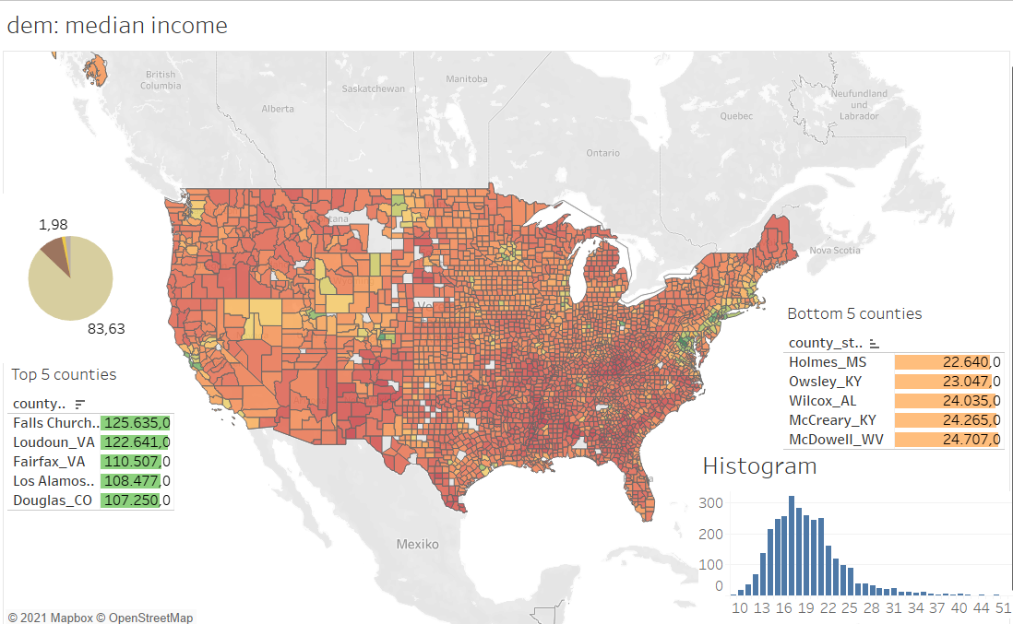
3. Data Exploration in Tableau

Slide 6
4. Challenges deep-dive
Challenge 1
Challenge 2
Challenge 3
Data joining
The key column was not an ID but a text field with different layouts
county name +
(suffix ‘county’, ‘city’, ‘parish’, ‘borough’ etc.) +
(state name full or abbr.)
Missing values & outliers
Substantial amount of missing values
→ Decision: fill values
Outliers in nearly every column
→ Decision: selective dropping and binning
Non-normal distributed features
Even though not a requirement for OLS, it can increase errors
→ Decision: transform or exclude due to insignificance

Slide 7
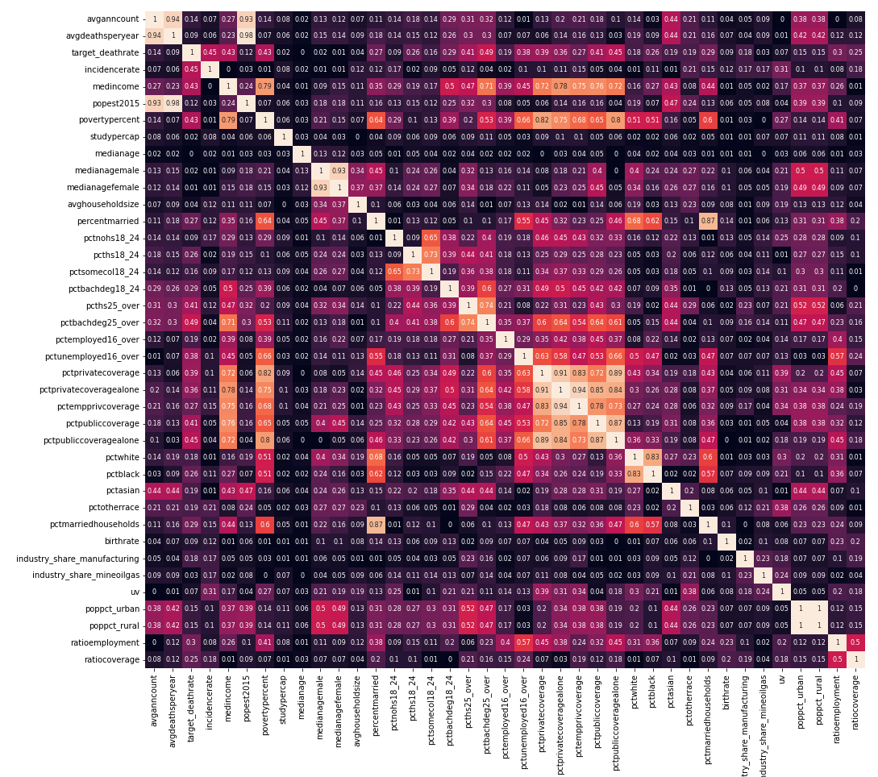
Excluding features due to high correlation
5. Data Cleaning and Preprocessing
Some features show high correlation between them
Excluded due to r>0.9
Average deaths per year
Population
Median Age Women
Private Coverage Alone
Privat Employee Coverage
Population Rural

Slide 8
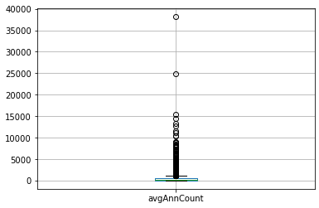
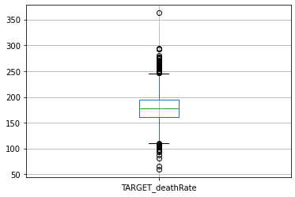
Outliers need treatment, but which works best?
5. Data Cleaning and Preprocessing
Outlier everywhere: across many columns but also across many different states
Worst Box-Plot Ever!?!
Method 1: Removing outliers
Method 2: Binning
Advantage: keep granularity
Disadvantage: lose sample size
Action: do a soft cut (3*IQR)
Sample Size before: 3053
Sample Size after soft cut: 1577
Advantage: keep sample size
Disadvantage: lose granularity
Action: continuous metrics 20-percentile bins each
(also tried different number and pd.cut, results remained equal)

Slide 9
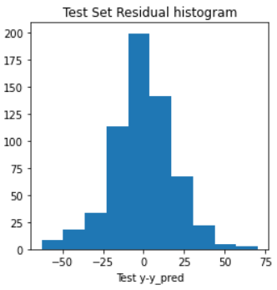
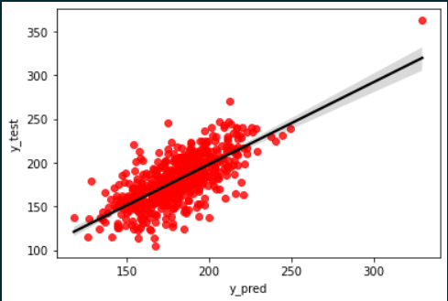
Model 1
6. Model Building & Results
Using everything, no exclusion of variables or outliers
Adj, R² = 0.52
Test Set R² = 0.51
RMSE = 19.2

Slide 10
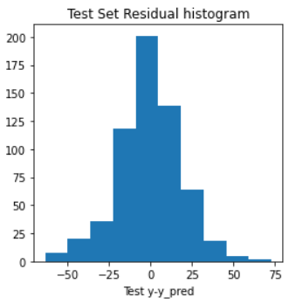
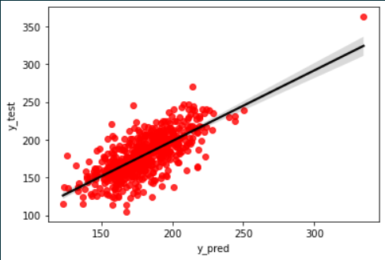
Model 2
6. Model Building & Results
Excluding high correlating features
Adj, R² = 0.51
Test Set R² = 0.51
RMSE = 19.3

Slide 11
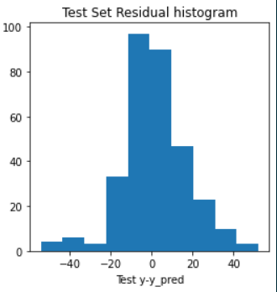
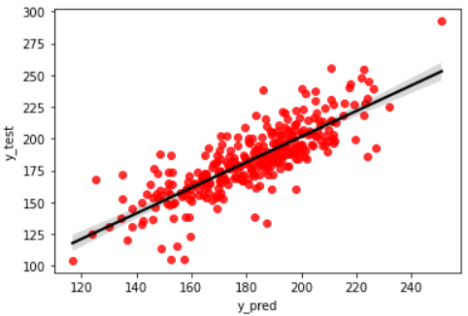
Model 3
6. Model Building & Results
Excluding outliers with soft cut
Adj, R² = 0.65
Test Set R² = 0.66
RMSE = 15.7

Slide 12
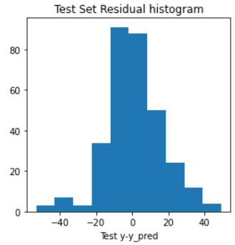
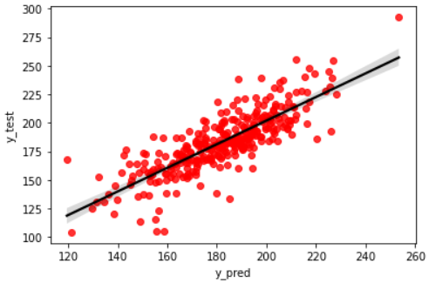
Model 4
6. Model Building & Results
Excluding outliers with soft cut
Excluding insignificant features from Model 3
Adj, R² = 0.64
Test Set R² = 0.66
RMSE = 15.6

Slide 13
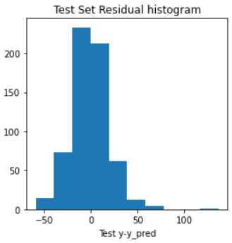
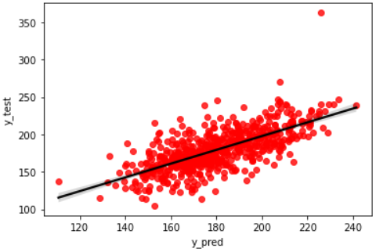
Model 5
6. Model Building & Results
Using bins for independent features
Adj, R² = 0.52
Test Set R² = 0.47
RMSE = 19.9

Slide 14
Model 6
6. Model Building & Results
Excluding outliers only on dependent variable
Keeping only significant features
Using polynomial features
Adj, R² = 0.55
Test Set R² = 0.35
RMSE = 18.7

Slide 15
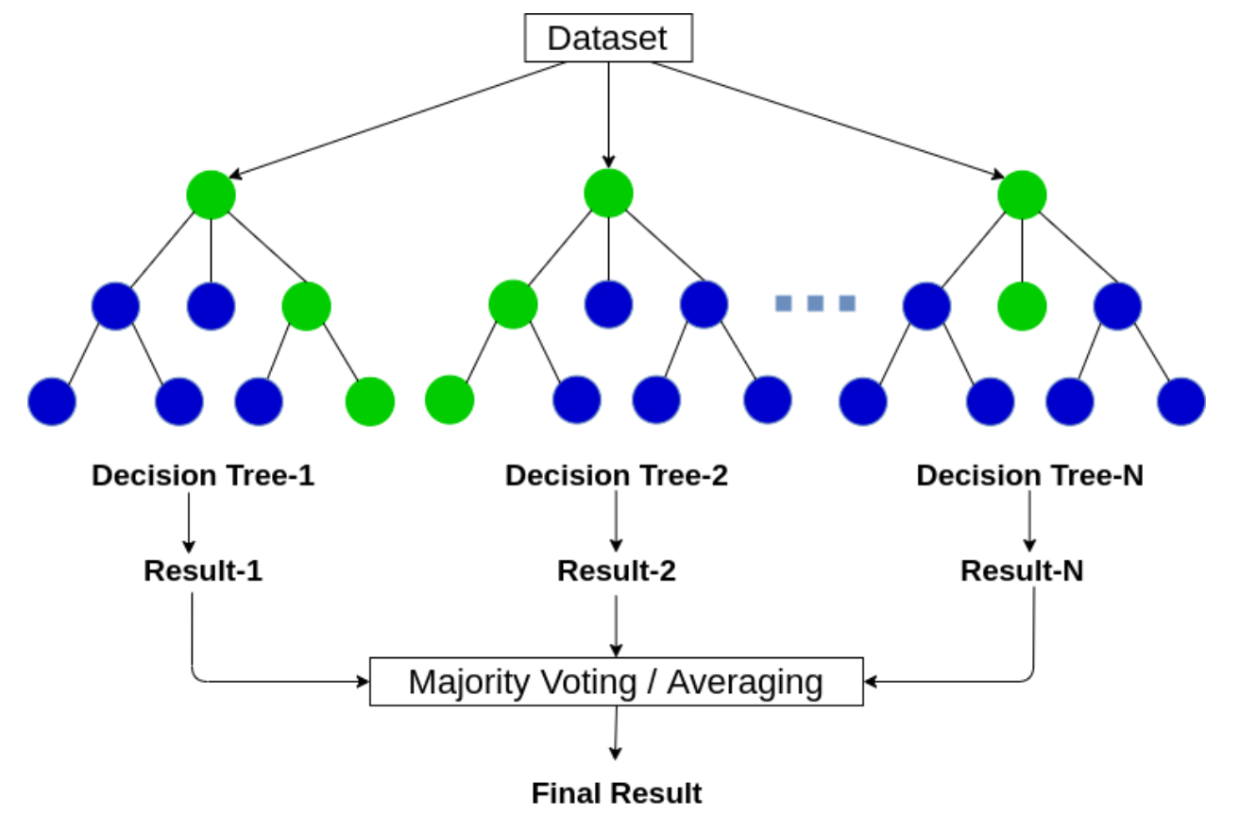
Random Forest

Slide 16
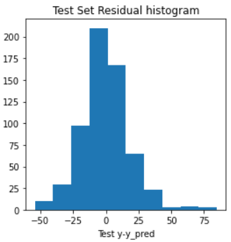
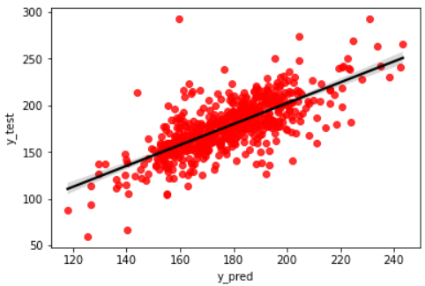
Model 7
6. Model Building & Results
Random Forest
Train Set R² = 0.94
Test Set R² = 0.53
RMSE = 17.9

Slide 17
Summary Model 3: Not accurate but plausible
Significant features with positive coefficient
Number of reported cancer cases absolute and relative
Median income
Poverty percent
Significant features with negative coefficient
Bachelor degree 25 years and older
Other race

Slide 18
8. Outlook: A challenge indeed
Challenging Dataset but participants of the challenge claim to have reach R² up to 0.86
Aggregated data is not optimal
I still need to learn more of best practices and tricks on model improvements
Keep on trying!!

Slide 19
Thank You

